Slide 1
Chapter 19 – Mitosis and Meiosis

Slide 2
19.1 Mitosis
You should be able to:
describe a chromosome as a length of DNA, sections of which are genes;
outline the process of mitosis; and
describe the role of mitosis in growth and asexual reproduction

Slide 3
19.1 Mitosis
The Cell Cycle
The cell cycle is a sequence of activities that occurs from the time a cell is formed until its own division into two daughter cells.
Duration of cell cycle varies greatly.
Most of the cell cycle is spent in interphase, where the cell
  Acquires nutrients
  Synthesises new organelles
  Duplicates chromosomes
  Grows in size
  The chromosomes are present in thin thread-like structures known as chromatin in the cell’s nucleus.

Slide 4
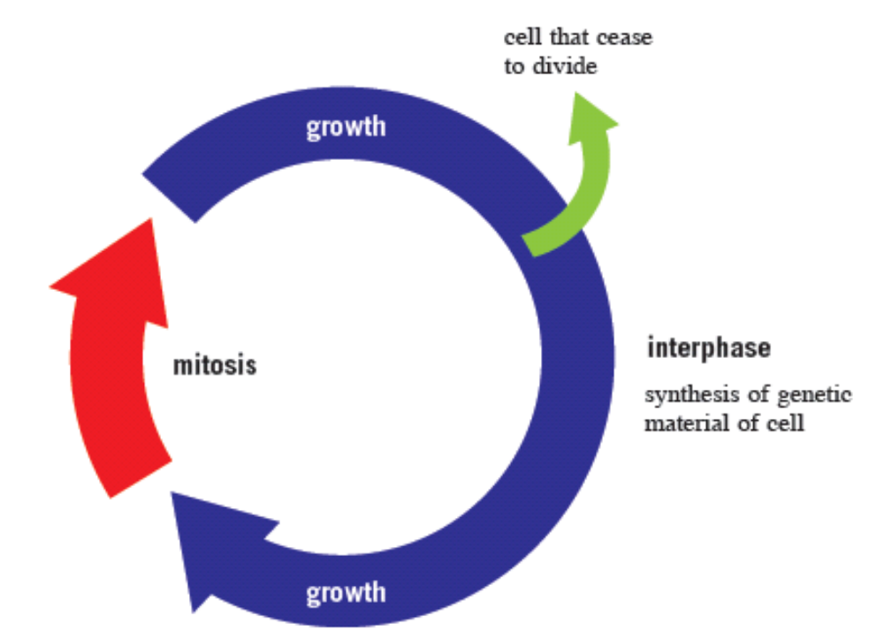
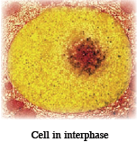
19.1 Mitosis
The Cell Cycle

Slide 5
19.1 Mitosis
Chromosomes and Genes
A gene is the basic unit of heredity in our cells.
Genes are found on chromosomes and comprise segments of DNA
Chromatin is the name given to DNA which is tightly coiled around small proteins.
Chromosomes are only visible during cell division as short, thick, X-shaped structures.

Slide 6
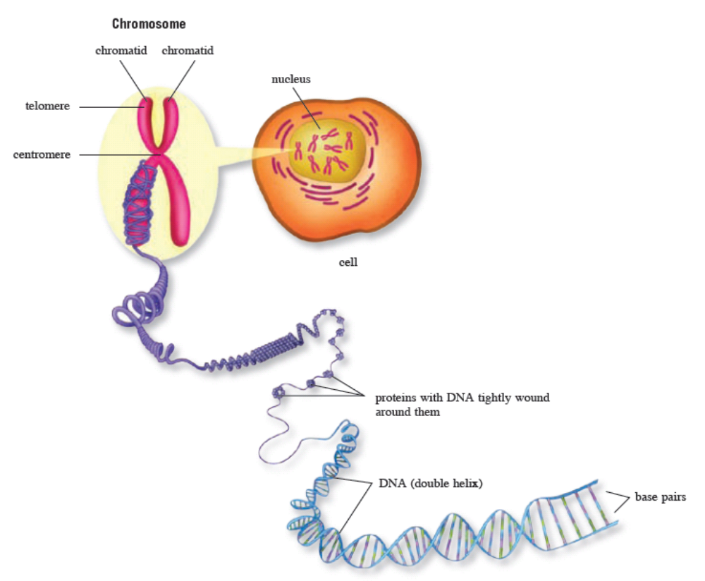
19.1 Mitosis
A chromosome comprises of a long strand of DNA

Slide 7
19.1 Mitosis
The nucleus of a human cell has 46 chromosomes, or 23 pairs of chromosomes. For each pair, one comes from the father, while the other comes from the mother.
The two chromosomes that form a pair are known as homologous chromosomes. The contain the same genes in the same sequence.
However, the genes may be different sometimes.
E.g.A gene coding for eyecolour. One gene may code for blue eye colour while the other codes for green eye colour.
Human cells contain 22 pairs of autosomes (non-sex chromosomes) and 1 pair of sex chromosomes, known as XX in females and XY in males.

Slide 8
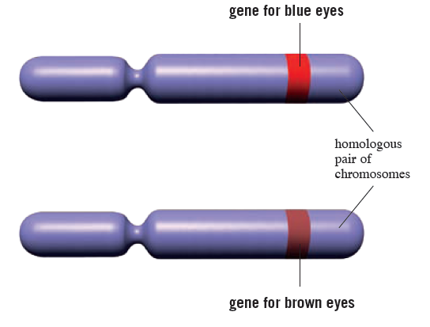
19.1 Mitosis
Homologous chromosomes are paired chromosomes containing different versions of the same gene.

Slide 9
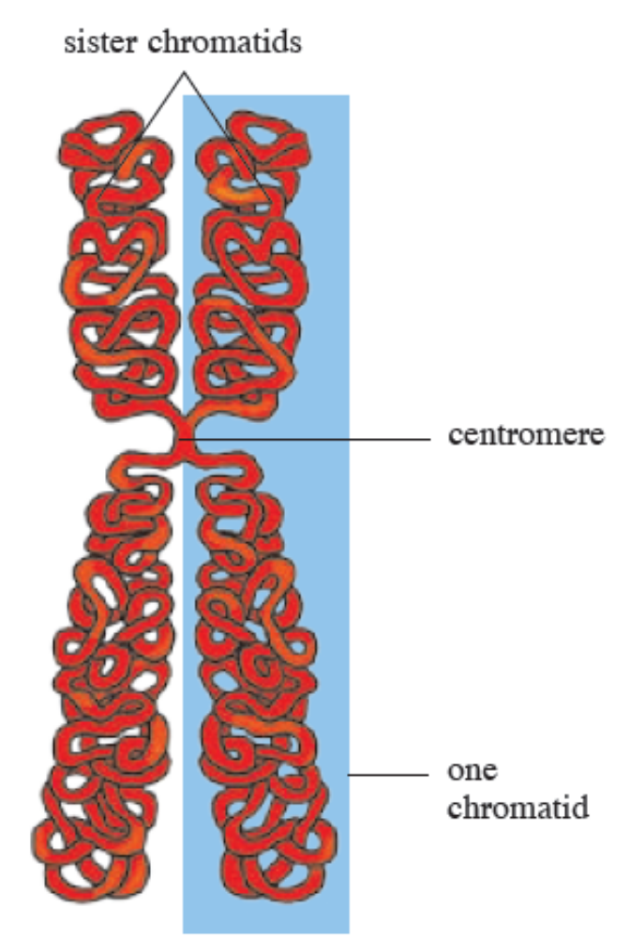
19.1 Mitosis
DNA Replication
DNA replication takes place during interphase.
A new identical DNA strand is formed using the existing DNA on the chromosome as a template.
The two identical DNA strands are attached to each other by a centromere, each strand known as a sister chromatid.

Slide 10
19.1 Mitosis
DNA Replication
Gene mutations can occur during DNA replication.
If an error occurs during the replication, the new DNA strand formed would be different from the original strand.
Serious mutations can lead to conditions such as cancer.
After DNA replication is complete and all other preparations for division are made, mitosis can occur.

Slide 11
19.1 Mitosis
Mitosis is the basis of asexual reproducton.
It is a process where cells divide to form daughter cells containing identical genetic material.
Mitosis is a continuous process with four main stages:
  Prophase
  Metaphase
  Anaphase
  Telophase

Slide 12
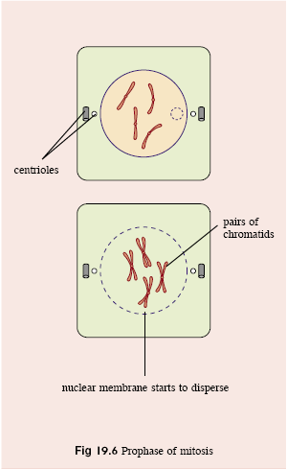
19.1 Mitosis
Prophase
Chromatin threads condense to form chromosomes.
Nucleolus disappears.
Rod-like structures, called spindle fibres, form. In animals, they grow out from the centrioles.
Nuclear membrane breaks down.

Slide 13
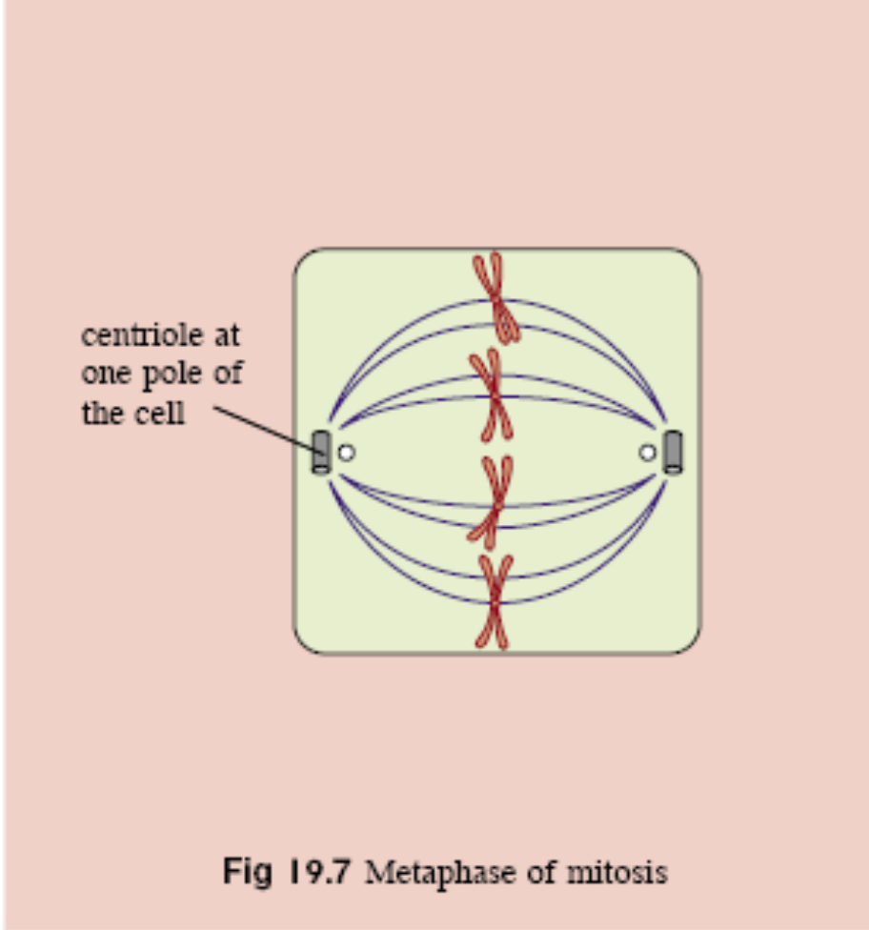
19.1 Mitosis
Metaphase
Centrioles move to opposite poles of the cell.
Spindle fibres connect chromosomes to centrioles.
Chromosomes align along the equator of the spindle.

Slide 14
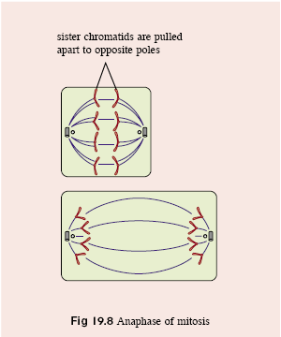
19.1 Mitosis
Anaphase
Centromeres split, allowing sister chromatids to separate.
Chromatids are pulled towards opposite poles.
Cell elongates.

Slide 15
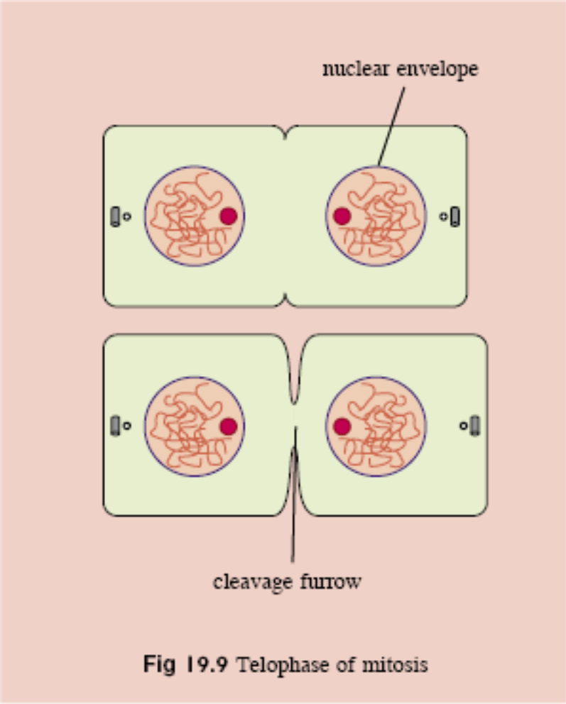
19.1 Mitosis
Telophase
Spindle fibres disintegrate.
Nuclear membrane forms around each set of chromosomes.
Nucleoli form.
Chromosomes uncoil and return to their original thread-like form.

Slide 16
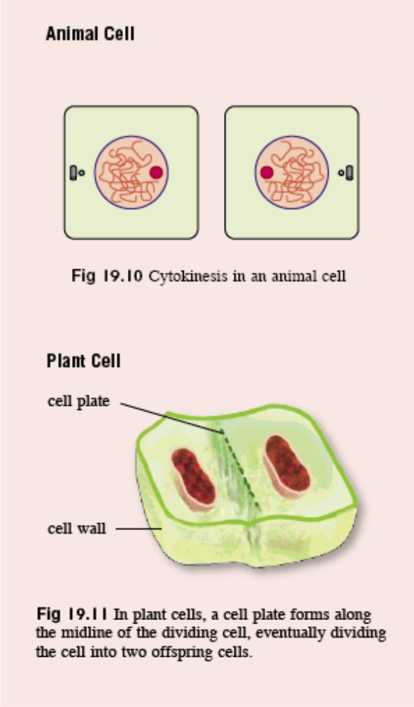
19.1 Mitosis
Cytokinesis
Cytokinesis is the division of the cytoplasm.
In animal cells, a cleavage furrow forms and splits the cell into two.
In plant cells, vesicles line up along the equator and fuse to form two membranes called the cell plate. A new cell wall forms from the vesicles.

Slide 17
19.1 Mitosis
Mitosis is essential for:
Growth
Repair
  Replace damaged or dead cells.
Asexual Reproduction
  Many species reproduce asexually, such as unicellular organisms and plants.
Animal Cloning
  Currently carried out by transferring the nucleus of a somatic donor cell to an egg cell with the nucleus removed.
  Useful in farming industries

Slide 18
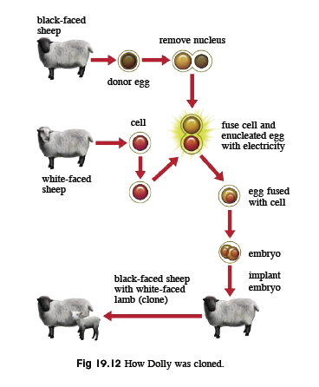
19.1 Mitosis

Slide 19
19.2 Meiosis
You should be able to:
outline the process of meiosis;
state the importance of halving chromosome number in the formation of gametes;
explain the role of gametes in the transmission of inheritable genetic characteristics;
explain how meiosis leads of variation; and
state the differences between mitosis and meiosis.

Slide 20
19.2 Meiosis
Meiosis takes place in the gonads (ovaries and testes)
Cells that have undergone meiosis will produce gametes containing half the number of chromosomes of the parent cell.
Unlike mitosis, meiosis is made up of two main phases – Meiosis I and Meiosis II

Slide 21
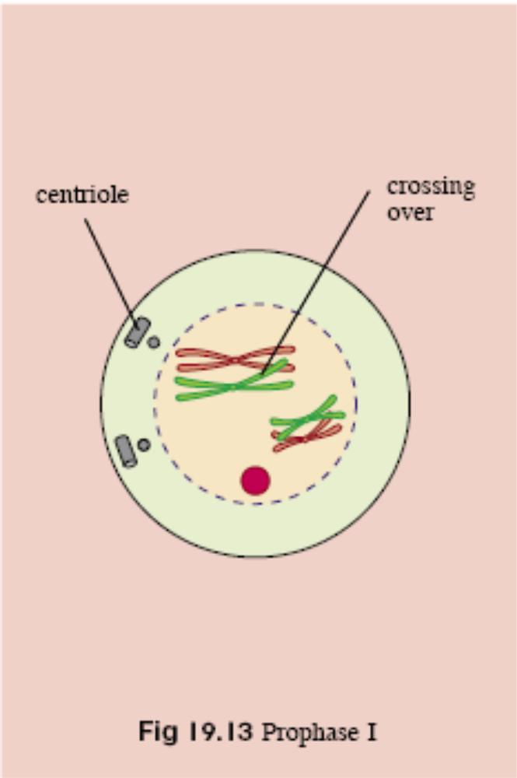
19.2 Meiosis
Prophase I
Chromosomes condense and become visible.
Nucleolus disappears.
Homologous chromosomes becomes closely associated and each pair is called a bivalent.
Crossing over takes place.
Nuclear membrane disintegrates.

Slide 22
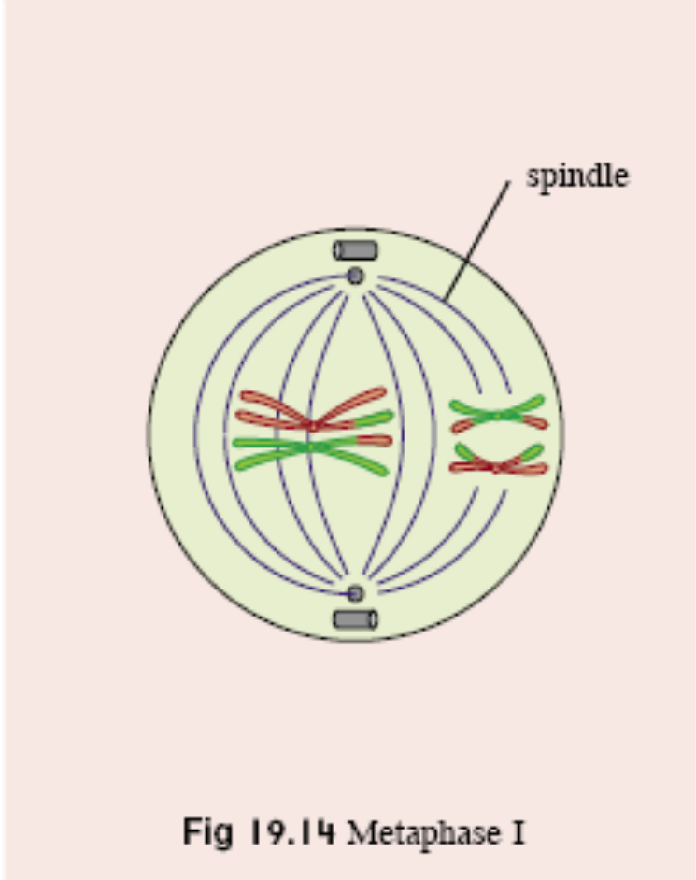
19.2 Meiosis
Metaphase I
Spindle fibres form.
Centrioles move to opposite poles of the cell
Homologous chromosomes line up next to each other on the equator. One of each pair faces the opposite pole.

Slide 23
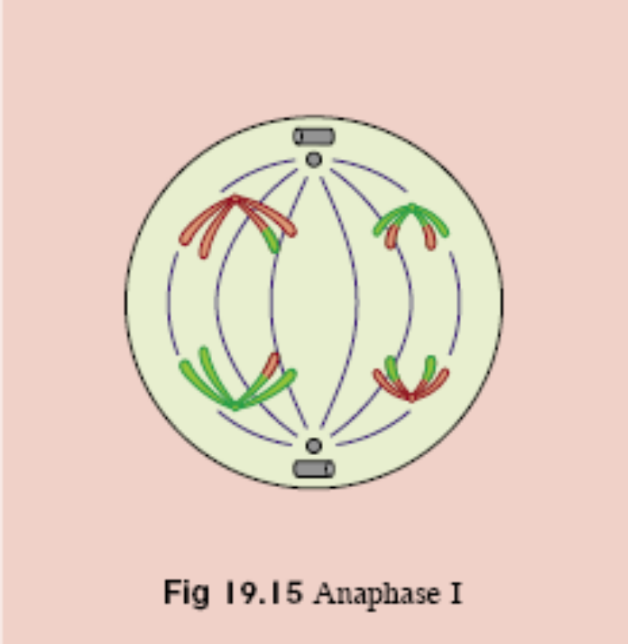
19.2 Meiosis
Anaphase I
One of each pair of homologous chromosomes is pulled to the opposite pole.

Slide 24
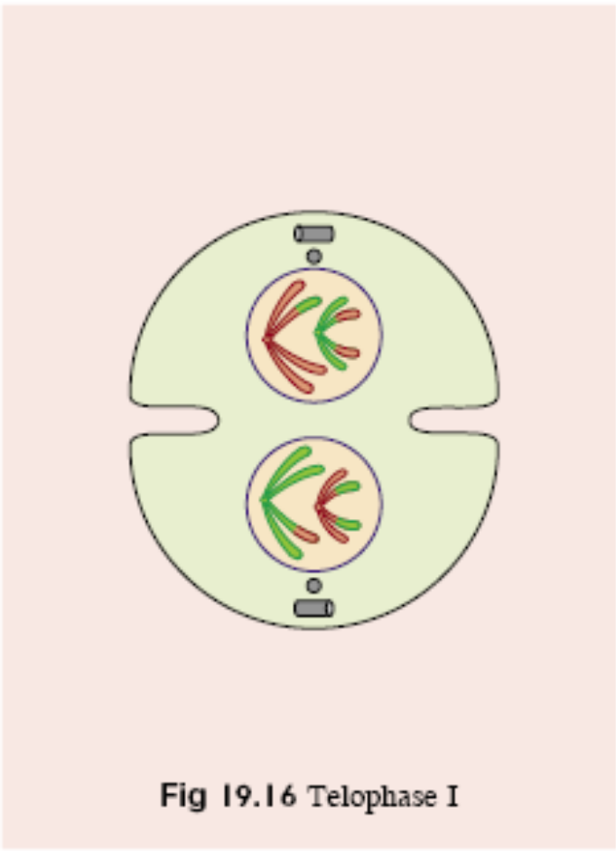
19.2 Meiosis
Telophase I
For animal cells, the nuclear envelope reforms around the chromosomes at each pole.
From this stage, the homologous pair is separated in different cells.
Most plant cells do not undergo Telophase I and move straight to Metaphase II.
Spindle fibres break down.
Centrioles divide.

Slide 25
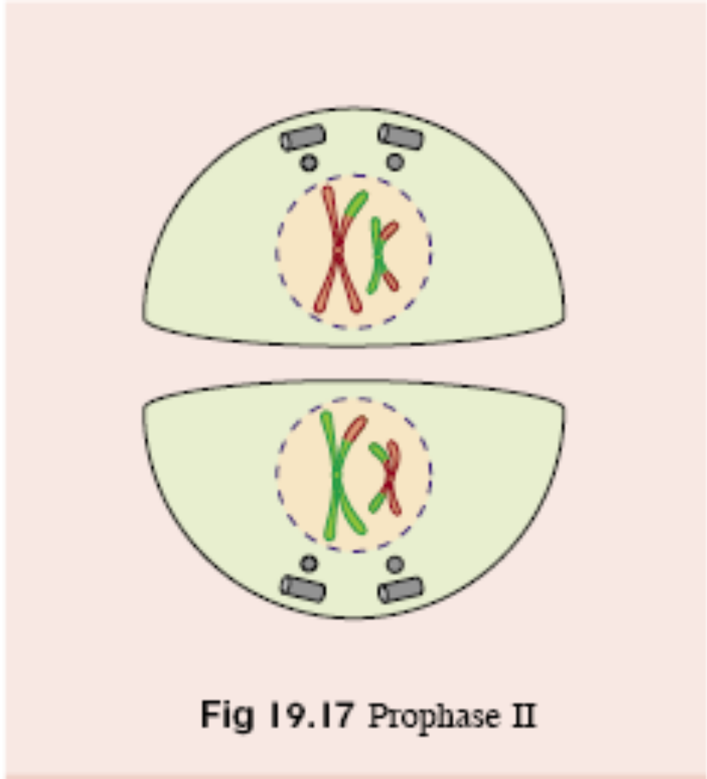
19.2 Meiosis
Prophase II
If the nuclear envelope has been reformed, it breaks down again.
Centrioles move to the opposite poles of the cell.
The nucleolus disappears, chromosomes condense and the spindle fibres reform.

Slide 26
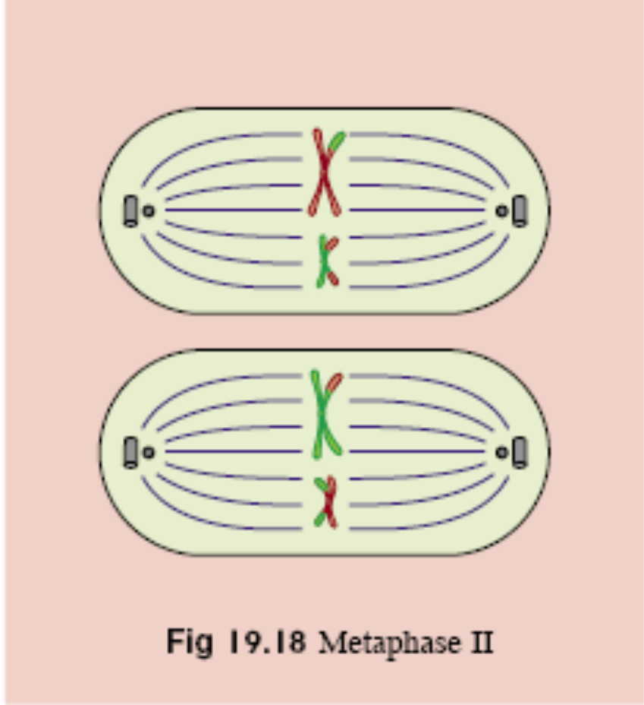
19.2 Meiosis
Metaphase II
Spindle fibres form at right angles to the plane of the first division.
The chromosomes align themselves along the equator.

Slide 27
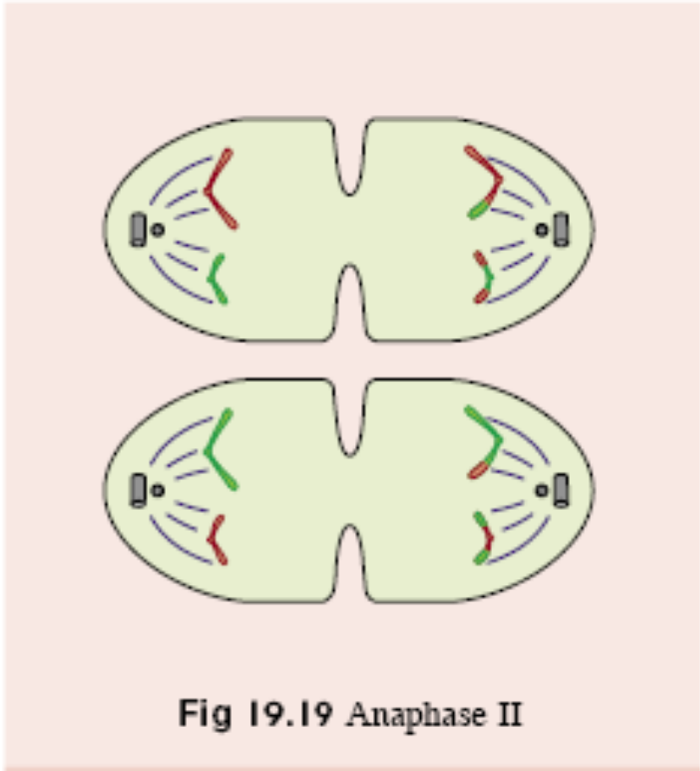
19.2 Meiosis
Anaphase II
The centromeres split.
Sister chromatids are separated and pulled to opposite poles of the cell.

Slide 28
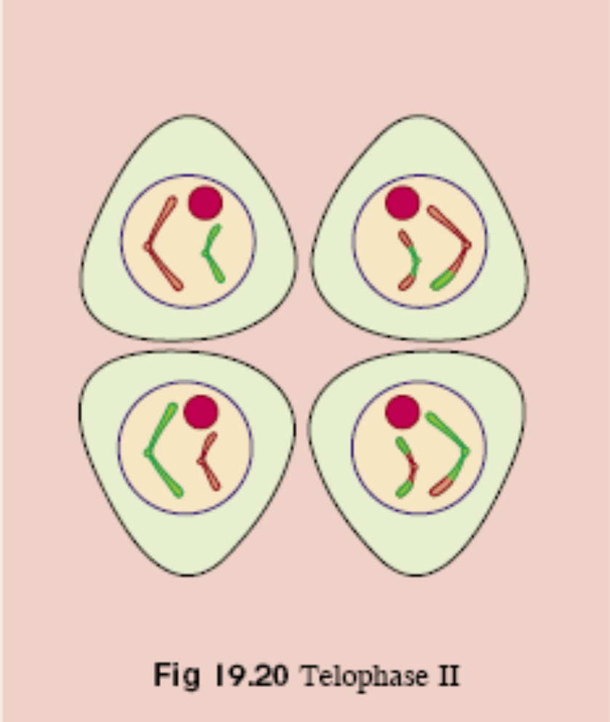
19.2 Meiosis
Telophase II
After separation, the chromatids become chromosomes in their own right.
Spindle microtubules disintegrate.
Nuclear envelope forms around each group of chromosomes.
Cells divide, forming four daughter cells with half a haploid number of chromosomes each.

Slide 29
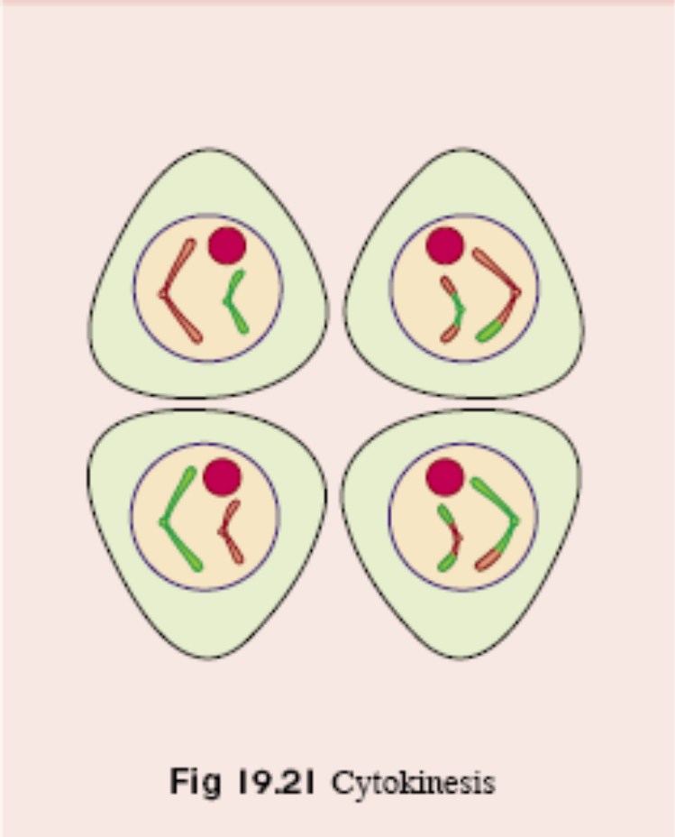
19.2 Meiosis
Cytokinesis
Cells divide, forming four daughter cells, each with one member of each pair of homologous chromosomes.

Slide 30
19.2 Meiosis
Importance of Meiosis
Halving of chromosome number
  Meiosis causes haploid cells to be formed from diploid cells
  When haploid cells fuse during fertilisation, the haploid number of chromosomes is restored.
Genetic variation
  Crossing over between homologous chromosomes (Prophase I)
  Independent assortment of homologous chromosomes (Metaphase I)

Slide 31
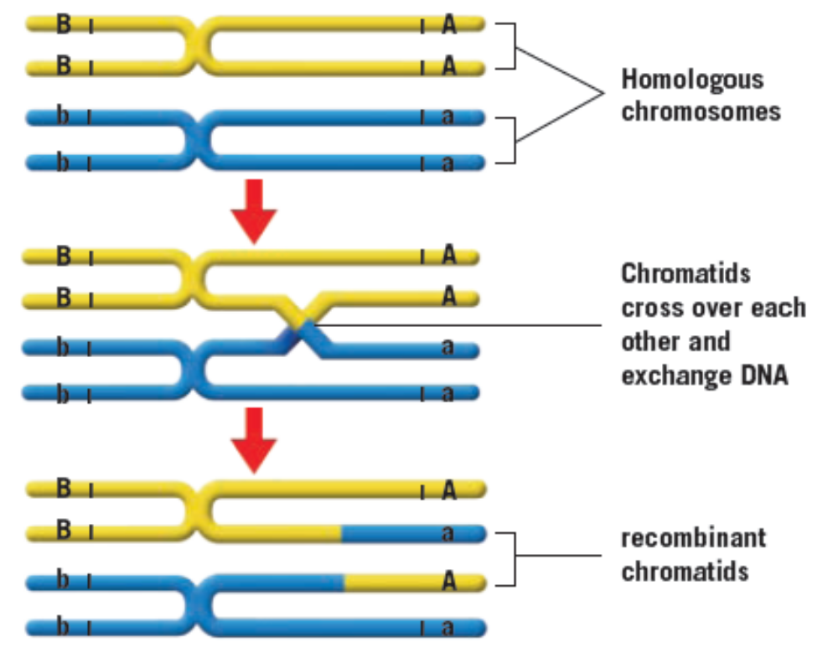
19.2 Meiosis
In the figure above, gene ‘a’ can only switch position with gene ‘A’ on its homologue. It cannot swap with gene ‘B’ on another section of the chromosome, or ‘b’ on the same chromosome.

Slide 32
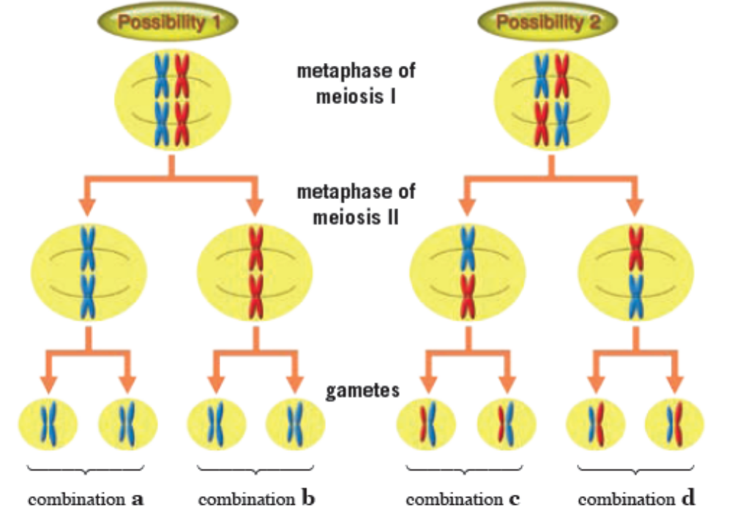
19.2 Meiosis
How independent assortment of chromosomes during metaphase I contributes to genetic variety in gametes

Slide 33
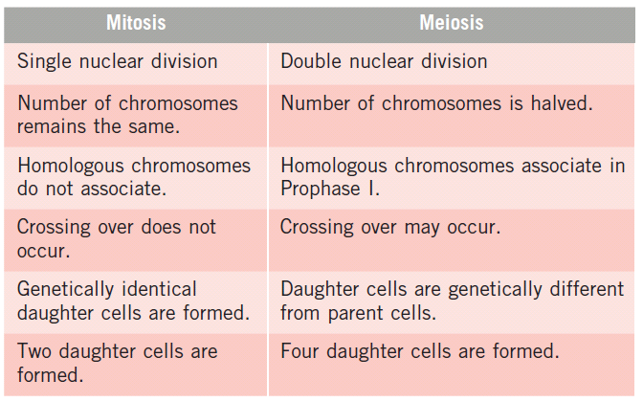
Comparison between mitosis and meiosis

Slide 34
Key Concepts
Before a cell divides, it spends most of its time in interphase, taking in nutrients and replicating its DNA.
Mitosis and meiosis are two types of nuclear division, where a cell divides to give rise to daughter cells.
Mitosis has four main stages – prophase, metaphase, anaphase and telophase.
Mitosis is important for growth, repair, asexual reproduction and cloning.
Each mitotic division gives rise to two identical, diploid, daughter cells.

Slide 35
Key Concepts
Meiosis produces haploid gametes from diploid parent cells.
Meiosis consists of Meiosis I and Meiosis II. Both consists of the prophase, metaphase, anaphase and telophase stages.
Meiosis ensures genetic variation by the processes of crossing over during Prophase I, and the process of independent assortment during Metaphase I.
The production of haploid gametes ensures that the number of chromosomes in an organism can be maintained through successive generations.

